Slide 1

In the meantime…
Chill music

Slide 2
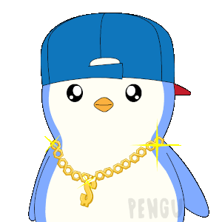

Introduction to LangChain
Beginner Workshop

Slide 3
What is LangChain?
Open-source development framework for LLM applications
Python and JavaScript (or TypeScript) packages are available
Focused on Composition and modularity
Key value adds:
Modular Components
Use cases: Common ways to combine components
Chase, H., & Ng, A. (n.d.). LangChain for LLM application development [Online short course]. DeepLearning.AI. Retrieved September 24, 2025, from https://www.deeplearning.ai/short-courses/langchain-for-llm-application-development/

Slide 4
What exactly is it?
Lang stands for language, which is the primary focus, and chain - the connotation of connecting things - refers to the chain component.
Chains are a sequences of instructions that the framework executes to perform a task.
It's about orchestration:
Chain multiple LLM calls together
Access external data (APIs, databases, documents, search, etc)
Remember context (short-term and long-term memory)
Control flow with tools, agents and structured reasoning

Slide 5
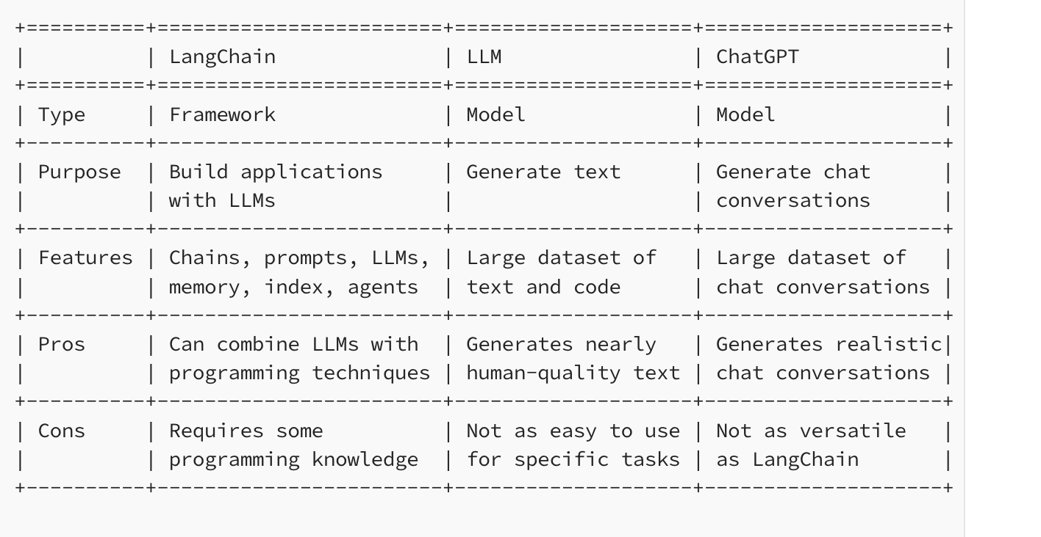
Reference from https://medium.com/@ivanreznikov/langchain-101-course-updated-668f7b41d6cb#678f

Slide 6
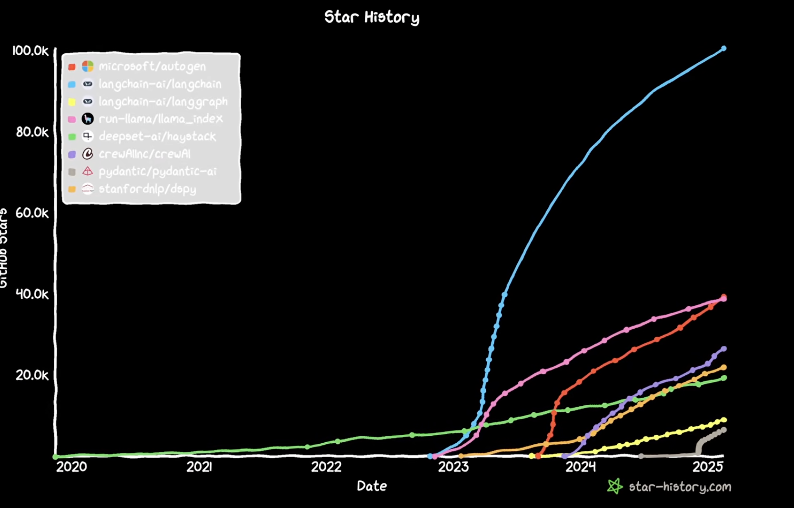

Slide 7
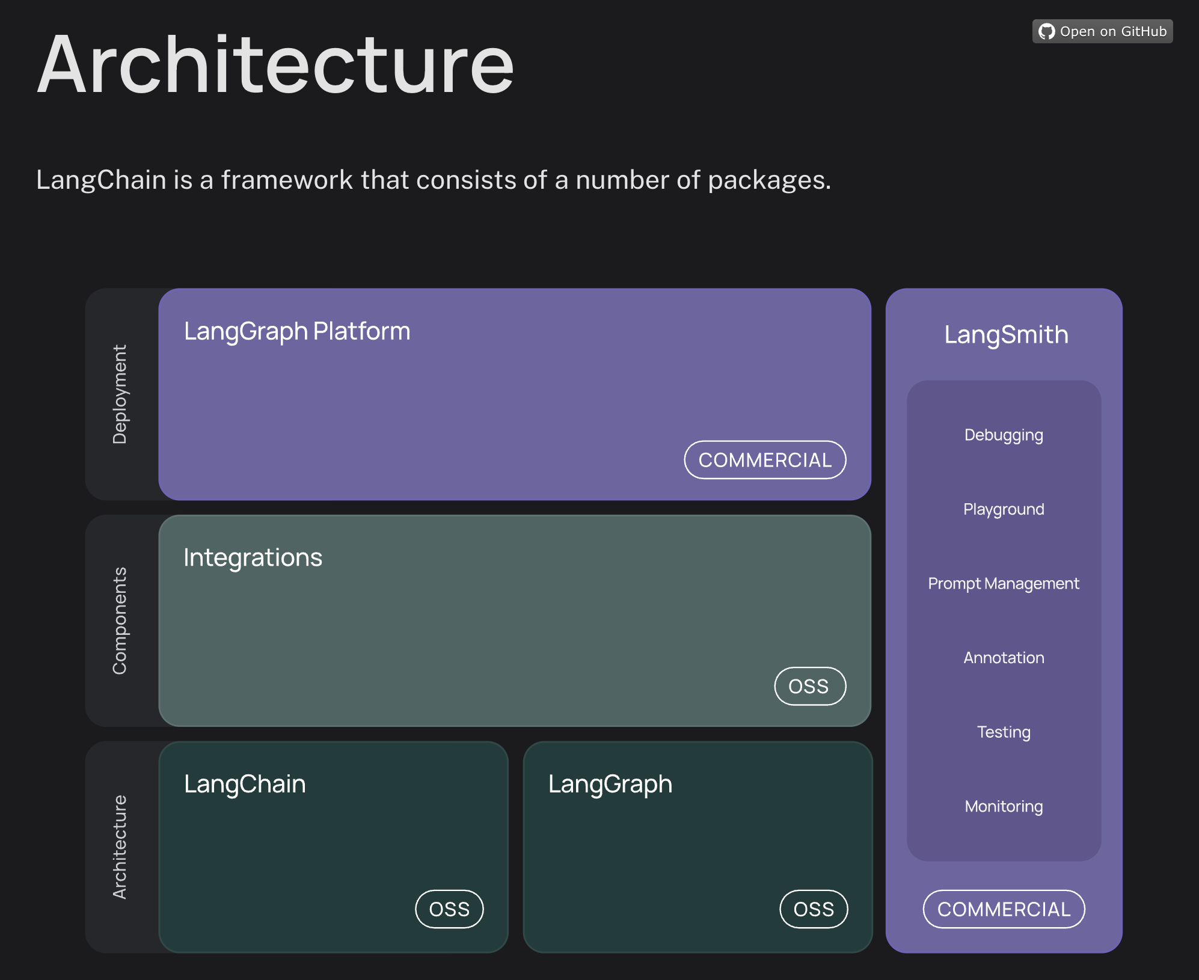

Slide 8
Basic Components of LangChain
Models: The “Brain” (e.g, GPT, Hugging Face Open Source Models)
Prompts: Instructions or templates guiding the model
Chains: Sequences that tie components together
Memory: Store and recall context across calls
Indexes: Connect LLMs with external knowledge
Agents and Tools: Let models decide which tools to call

Slide 9
Deep Dive into Workshop Focus
Today, we’ll go deeper into these areas:
Models: LangChain lets you plug in different LLMs. We are going to plug in an open source LLM from Hugging Face
Prompts: Instead of raw strings, LangChain gives you structured prompt templates. Allowing you to inject variables, manage context, and avoid mistakes in prompt engineering.
Chains: Sequences that tie components together
Output Parsers: Allows you to parse the model’s raw text into structured output

Slide 10
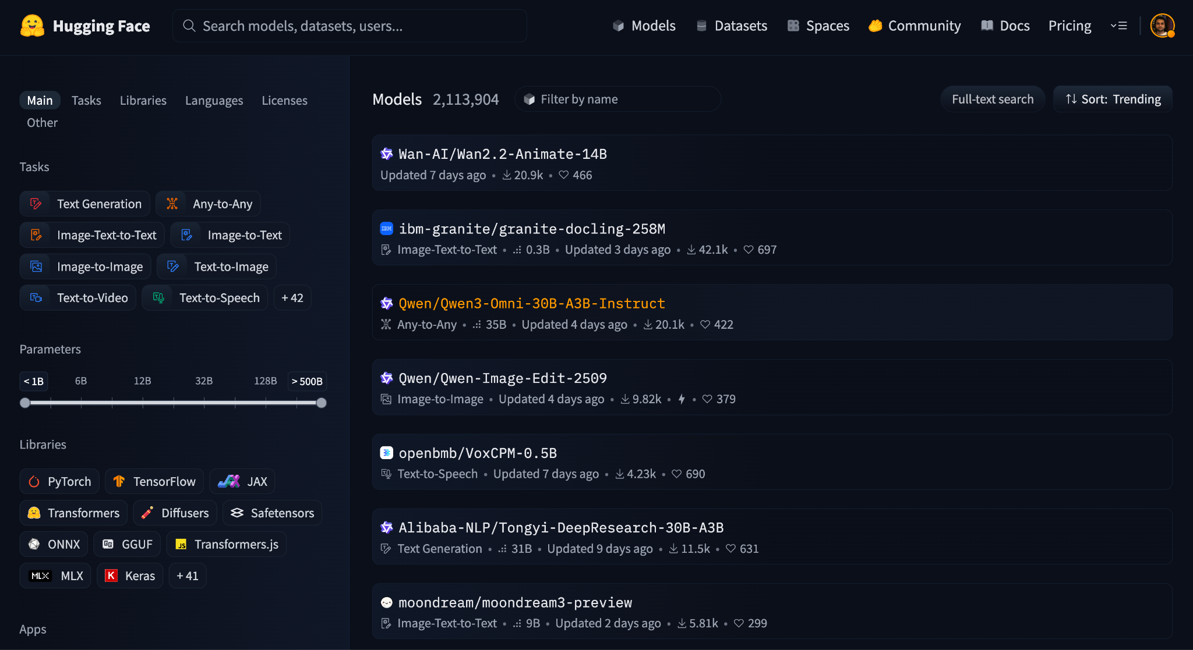

Slide 11
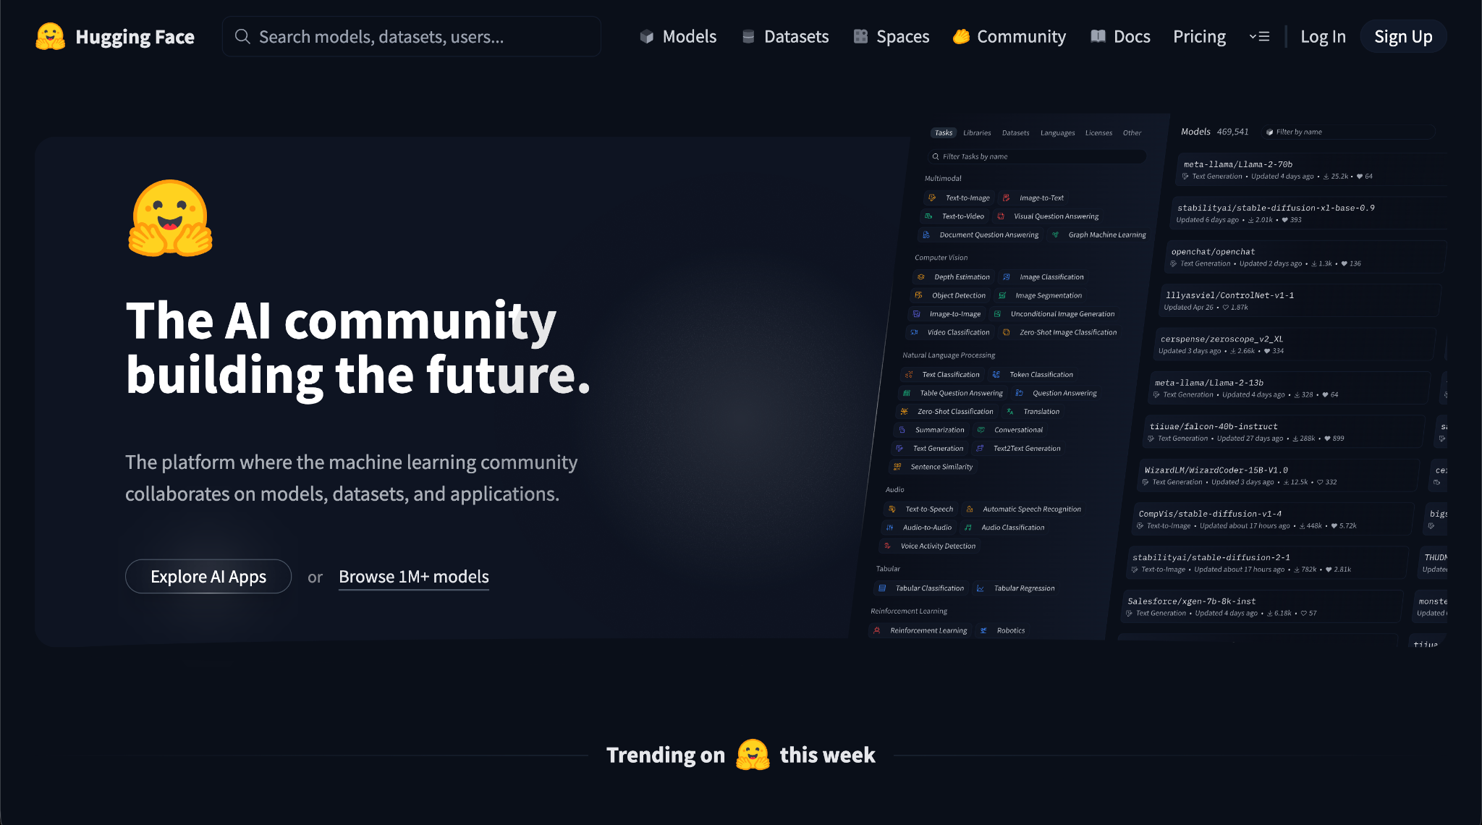
Notes:
Models are the foundation. LangChain lets you plug in different LLMs—from OpenAI, Anthropic, Cohere, or Hugging Face.
For example, Hugging Face hosts thousands of open-source models—from small distilled models to large instruct-tuned LLMs.

Slide 12
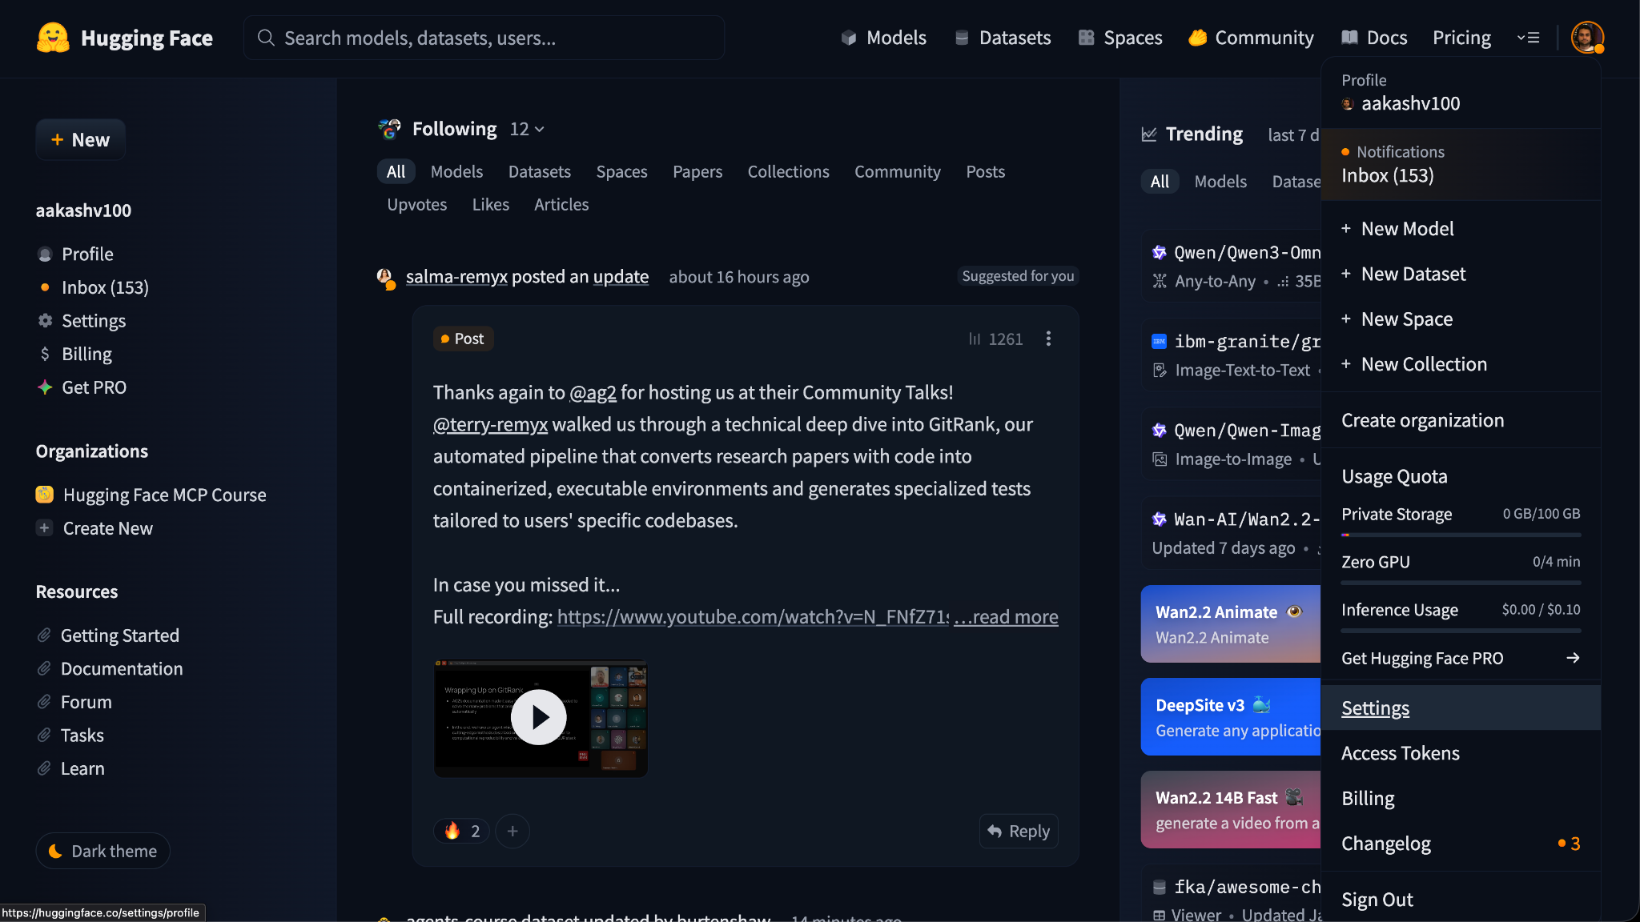

Slide 13
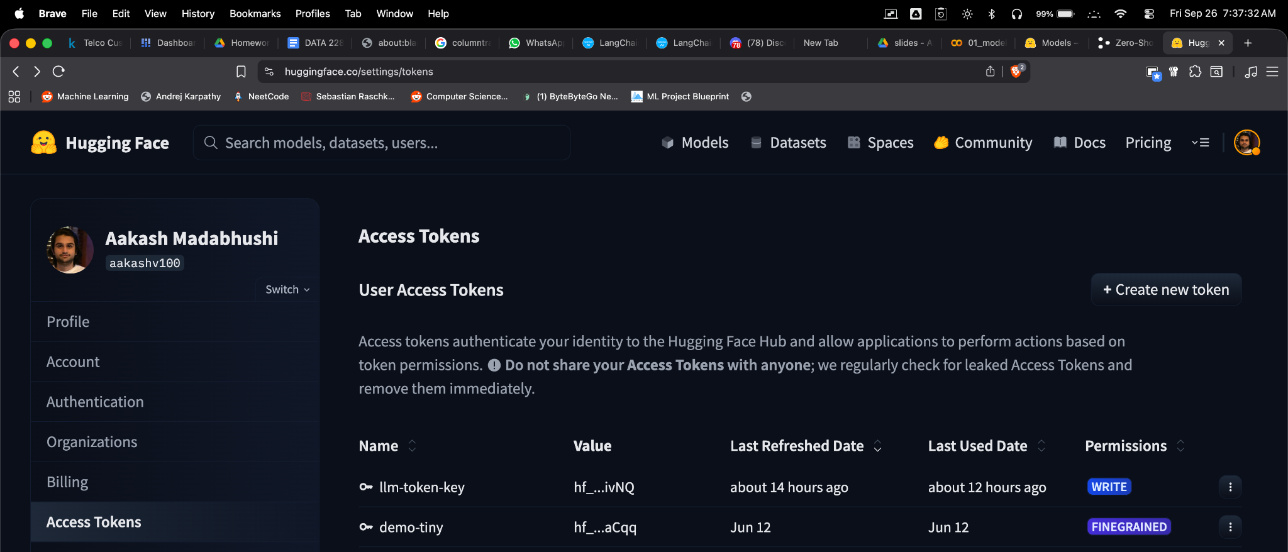

Slide 14
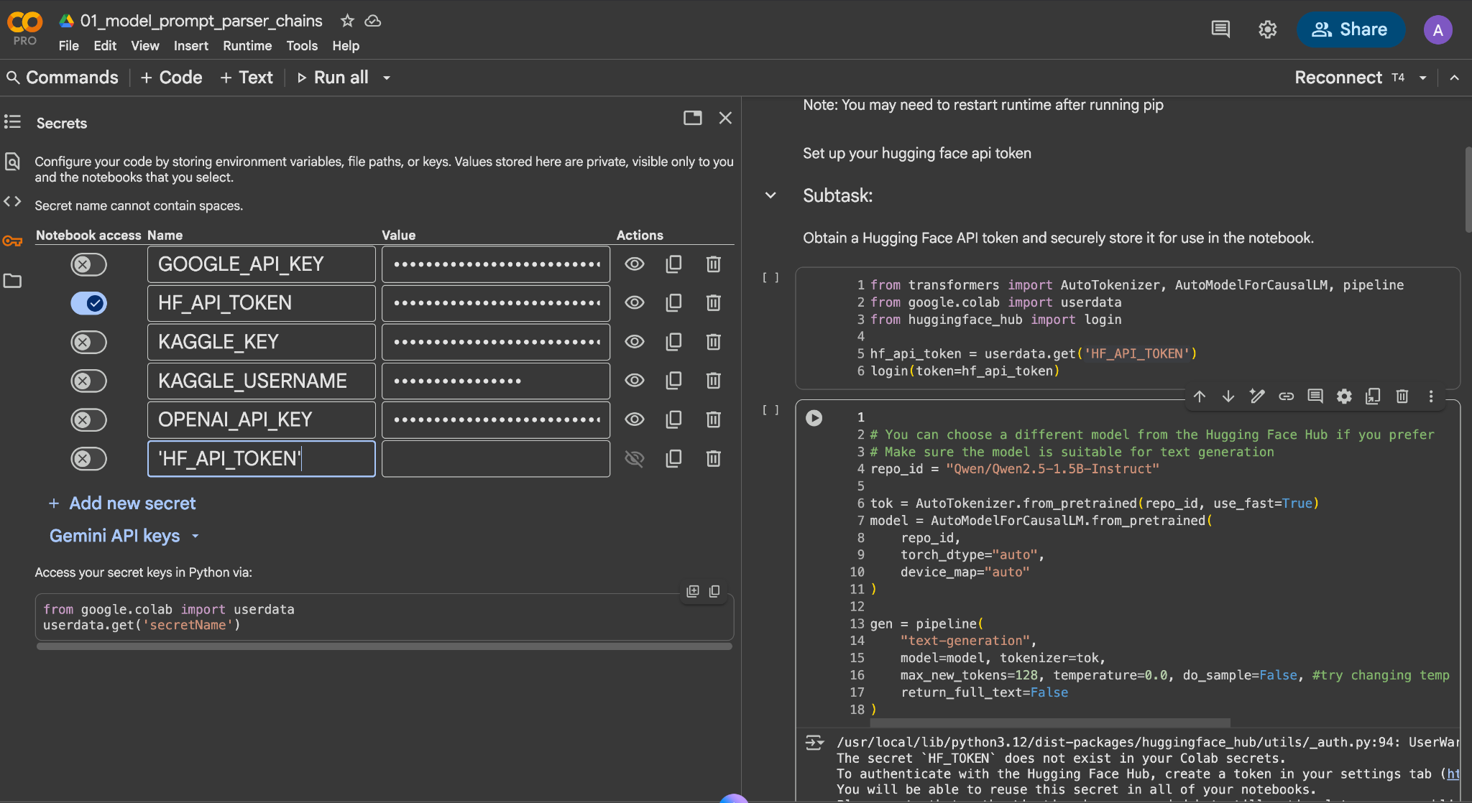
Copy & Paste Token Key here

Slide 15
Click the Colab Link: here

